Slide 1
Design, Testing and Agile
Chapter 9 (Part 2)

Slide 2
Design issues
In the previous session, we looked at Pair Programming and TDD
Do you remember?
What the terms Driver and Navigator mean in Pair Programming?
What three steps are there in TDD?
In this session, we will think about the design and how an Agile project using a technique like XP (eXtreme Programming) thinks about design and testing and quality control.

Slide 3
Overview
Refactoring
When do the developers create the design in an Agile project?
Designing to make it easier to test the software

Slide 4
Red
Green
Refactor

Slide 5
“Refactoring is the process of changing a software system in such a way that it does not alter the external behavior of the code yet improves its internal structure. It is a disciplined way to clean up code that minimizes the chances of introducing bugs. In essence when you refactor you are improving the design of the code after it has been written.”
Martin Fowler, Refactoring. Improving the design of existing code. Addison Wesley, 1999
Image source:
https://commons.wikimedia.org/wiki/File:Webysther_20150414193208_-_Martin_Fowler.jpg, This file is licensed under the Creative Commons Attribution-Share Alike 4.0 International license.

Slide 6
“Refactoring is the process of changing a software system in such a way that it does not alter the external behavior of the code yet improves its internal structure. It is a disciplined way to clean up code that minimizes the chances of introducing bugs. In essence(本质) when you refactor you are improving the design of the code after it has been written.”
Martin Fowler, Refactoring. Improving the design of existing code. Addison Wesley, 1999
Image source:
https://commons.wikimedia.org/wiki/File:Webysther_20150414193208_-_Martin_Fowler.jpg, This file is licensed under the Creative Commons Attribution-Share Alike 4.0 International license.

Slide 7
“I am not a great programmer. I am a good programmer with great habits.”
Kent Beck, quoted in Refactoring. Improving the Design of Existing Code.

Slide 8
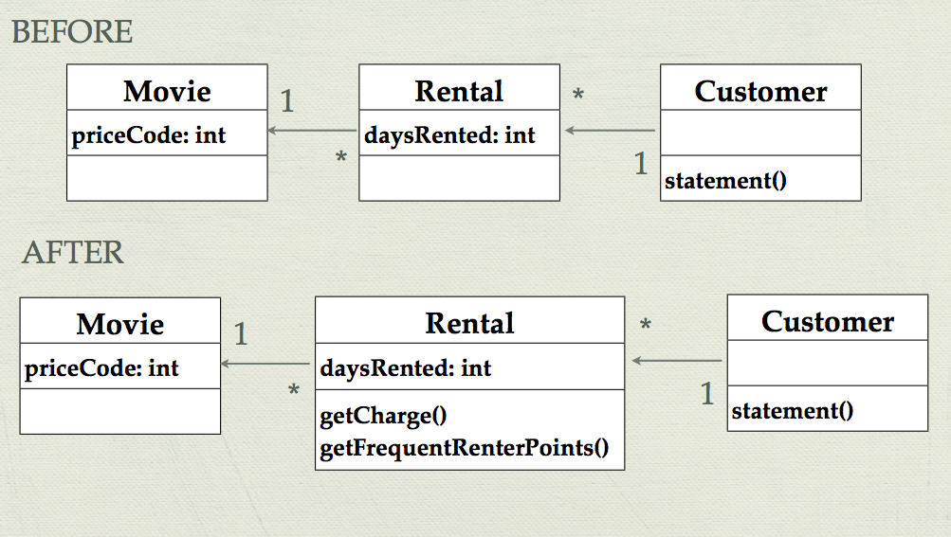
Example Outline
Use refactoring to modify the Movie rental example.
Notes:
Recap of the example from chapter 1 of Martin Fowler’s Refactoring book.

Slide 9
Refactoring steps
The example uses the following Refactorings:
Extract Method
Move Method
Replace Temp with Query
Full details are in the book, and a summary is available online:
http://refactoring.com/catalog/

Slide 10
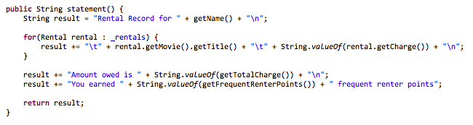
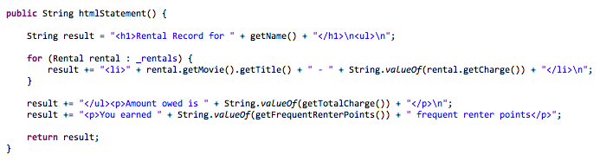

Slide 11
Refactor
Red
Green
Refactor

Slide 12
“Any fool can write code that a computer can understand. Good programmers write code that humans can understand.”
Martin Fowler, Refactoring. Improving the design of existing code. Addison Wesley, 1999

Slide 13
Is TDD really about analysis and design?
There is a short paper (Aim, fire [test-first coding]) by Kent Beck in IEEE Software journal (2001). It states the following:
“Test-first coding is not a testing technique” Ward Cunningham
What could this mean?
Notes:
We normally talk about Test-Driven Development as a testing technique that builds up a set of tests. That is good as a way to specify what the system is capable of – issue of living documentation – and also supports future refactoring.
Is that its primary focus?
This quote from Ward Cunningham (one of the signatories on the Agile Manifesto and worked on XP with Kent Beck), suggests not.
Ask the questions to think about this issue – a couple of minutes for discussion and then invite comments. [There is the possibility that similar points were raised in the earlier discussion. If so, this is a space to review that and carry on to the next slide.]

Slide 14
Is TDD really about analysis and design?
Kent Beck goes on to talk about two key aspects:
Analysis
As you design the tests, you are required to think more about what new functionality the system needs.
You start with a story, but in XP, TDD is used as part of the conversation to confirm the details of what is required
Design
Similar issue for design. Once you decide on what should be done (the analysis), you need to decide what is changed about the system to do that.
What function/method will be added or changed?
What situations does the code need to cope with (normal and exceptional)?
Notes:
If TDD isn’t a testing technique, then what is it? Kent Beck highlights two aspects: Analysis and Design.
The value is the time taken to think: For analysis, it is the chance to think further about how a story becomes a set of features. Within XP, there would be the opportunity for discussion with the client. TDD might prompt some of that discussion, but it also forces the developers to think further about what is needed for the story.
Kent Beck does say elsewhere “If you can’t write a test to say what should happen, do you understand the new functionality well enough?”
It is a similar issue for design. If you are going to write a unit test, you need to know which part of the system is going to be tested. That forces discussion and decision about where the new code will be – so prompting discussion about the design.
[If time: could mention that if we link this to Pair Programming in XP, we are moving beyond an individual preparing the analysis and design, but prompting the pair to discuss the analysis and design, so getting a more rounded view].

Slide 15
When do the developers create the design in an Agile project?
In XP (eXtreme Programming), it happens in different ways:
A project is arranged in iterations – the team commits to add new functionality on each iteration
At the start of the iteration, there is discussion in the team about the design for the new features and any possible changes to the existing code
Developers talk in pairs – discussing the design as they add tests and code and review the new code
There is daily stand-up meeting each day – a place to ask for ideas about design issues
Work on refactoring
Team interactions during the iteration

Slide 16
When do the developers create the design in an Agile project?
In XP, there is often not a written design specification
Some people think that is a bad way to build software
This doesn’t mean that an XP cannot write details about the design, but the focus is on working code.
Let’s look at the Agile Manifesto

Slide 17
Manifesto for Agile Software Development
We are uncovering better ways of developing software by doing it and helping others do it. Through this work we have come to value:
Individuals and interactions over processes and tools
Working software over comprehensive documentation
Customer collaboration over contract negotiation
Responding to change over following a plan
That is, while there is value in the items on the right, we value the items on the left more.
Kent Beck, Mike Beedle, Arie van Bennekum, Alistair Cockburn, Ward Cunningham, Martin Fowler, James Grenning, Jim Highsmith, Andrew Hunt, Ron Jeffries, Jon Kern, Brian Marick, Robert C. Martin, Steve Mellor, Ken Schwaber, Jeff Sutherland, Dave Thomas
© 2001, the above authors • Taken from http://agilemanifesto.org/

Slide 18
Designing to make it easier to test the software
As we write code, we should think about how easy it is to test
Shorter methods and functions – less complexity
Code with low coupling and high cohesion
Separating application logic out of the user interface code

Slide 19
Designing to make it easier to test the software
In Java, we can use Interfaces to make it easier to test
With Interfaces we can create Test Stubs, use Mocking and reduce the coupling in the software
Dependency Injection – the ability to set the DOC that an SUT might use
This means that we can swap the real DOC for one that makes it easier to test – e.g. Test Doubles.

Slide 20
Design, Testing and Agile
Agile projects take a different approach to building software and organising the team
Not as much documentation
Emphasis on working code and tests for that code
Different Agile approaches – we have looked at some ideas from XP
Aim to develop design with information we have about requirements – be prepared to change - use tools to support this

Slide 21
Any Questions?

